Slide 1
Using Genetic Algorithm to solve Travelling salesman Problem (TSP)
7110064481 紀政均

Slide 2
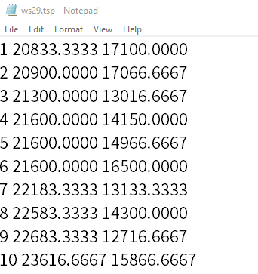
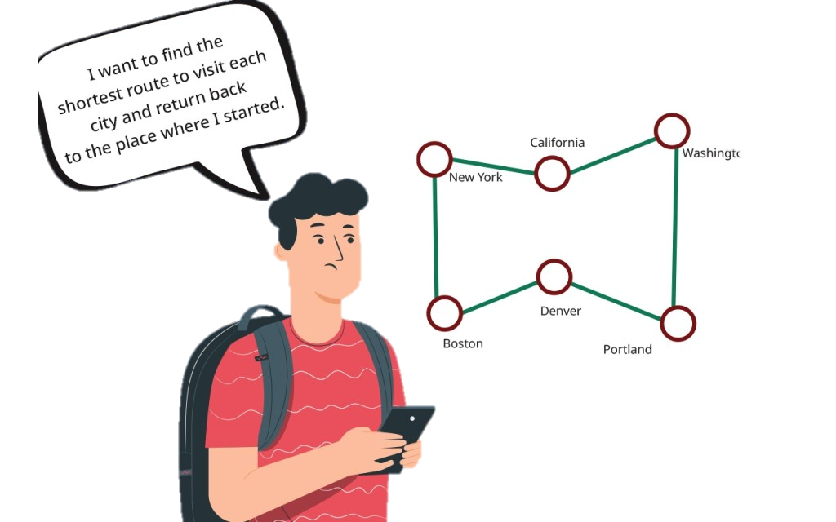
Problem
Given a list of cities and the distances between each pair of cities, what is the shortest possible path that visits each city exactly once and returns to the origin city?
Num x y

Slide 3
Process
Generate a bunch of random possible paths
Select the shorter paths
Crossover
Mutation
Generate new paths
Repeat

Slide 4
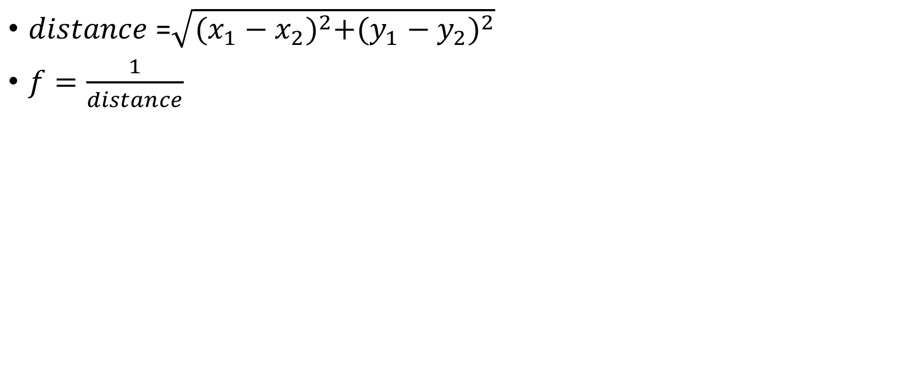
Fitness Function
$distance$ =$\sqrt{{(x_{1}−x_{2})}^{2}+{(y_{1}−y_{2})}^{2}}$
$f=\frac{1}{distance}$

Slide 5
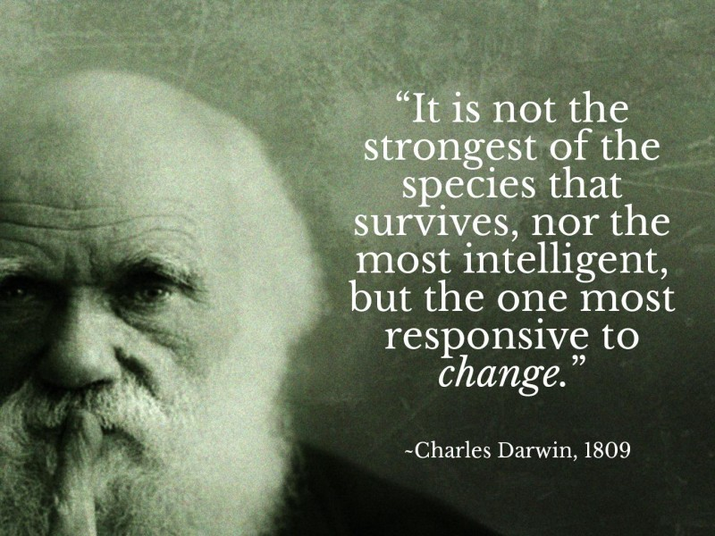
Selection
species = the paths Ex: [1,2,3,4,1]
Use Roulette Wheel Selection, but keep the top 10% of species with high fitness

Slide 6
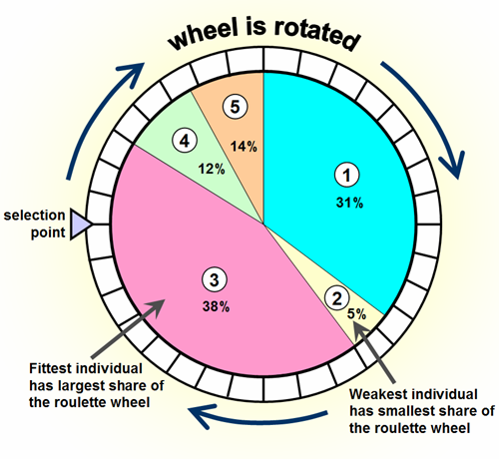
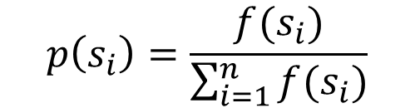
Roulette Wheel Selection
weights:
$$p\left(s_{i}\right)=\frac{f(s_{i})}{\sum_{i=1}^{n}{f(s_{i})}}$$

Slide 7
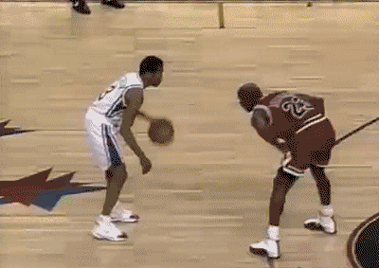
Crossover

Slide 8
Crossover
Randomly select a number as a node then swap the two sides with the node as a center
Swap the repeated cities again
Crossover rate: 70%
0 1 2 3 4
Parent 1
1 2 5 3 4
Child 1
1 2 5 3 1
Swap
the repeated cities
Swap
Crossover
Parent 2
4 5 2 3 1
Child 2
4 5 2 3 4
0 1 2 3 4
Randomly select

Slide 9
Mutation
Randomly select 2 nodes and reverse the order of city between the nodes
Mutation rate: 20%
Reverse
Child 1
1 2 5 3 4
Child 1
1 3 5 2 4
0 1 2 3 4
Mutation
0 1 2 3 4
Randomly select

Slide 10

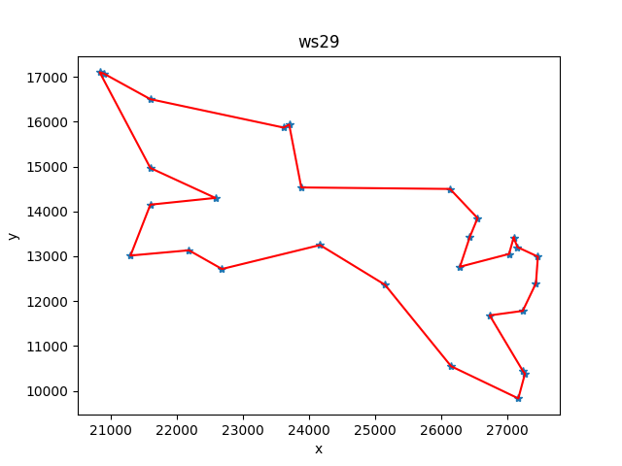
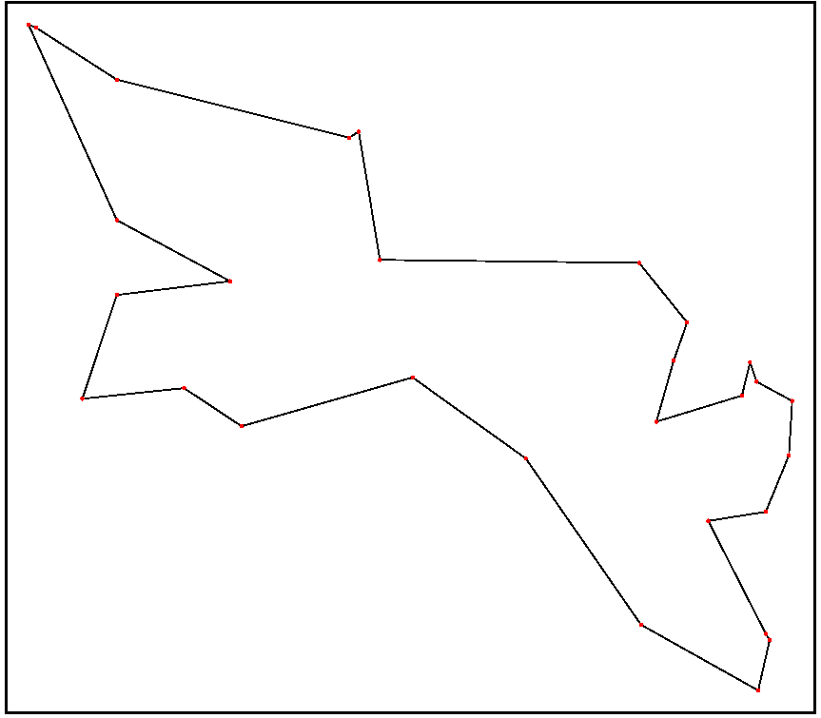
Result
Western Sahara: 29 Cities
Ans

Slide 11

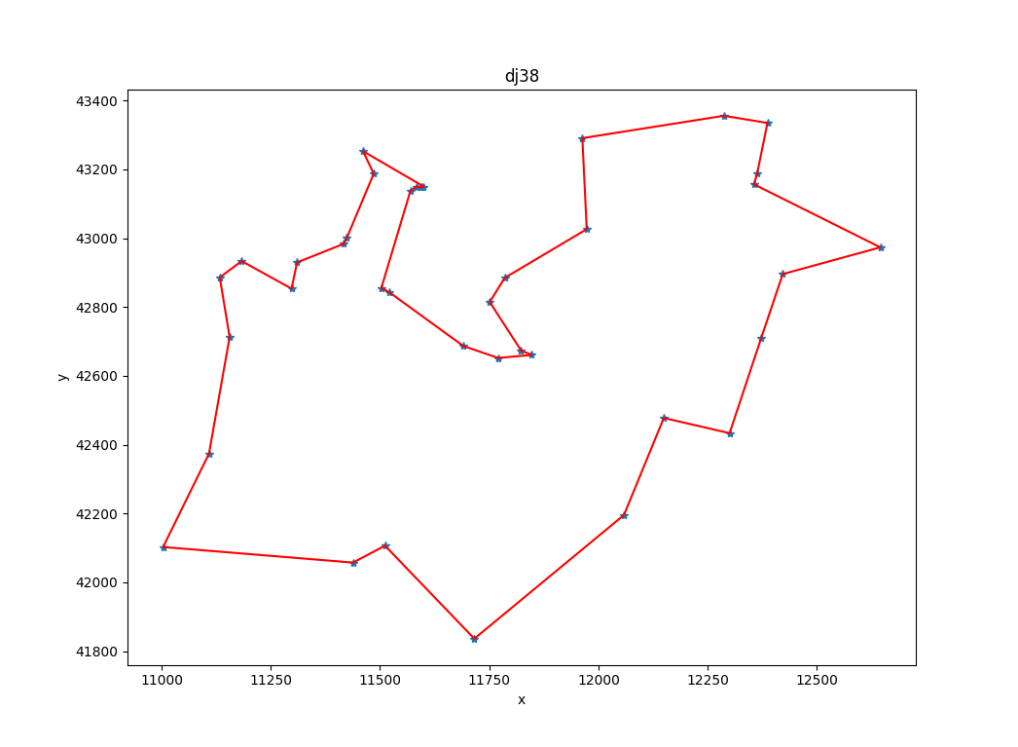
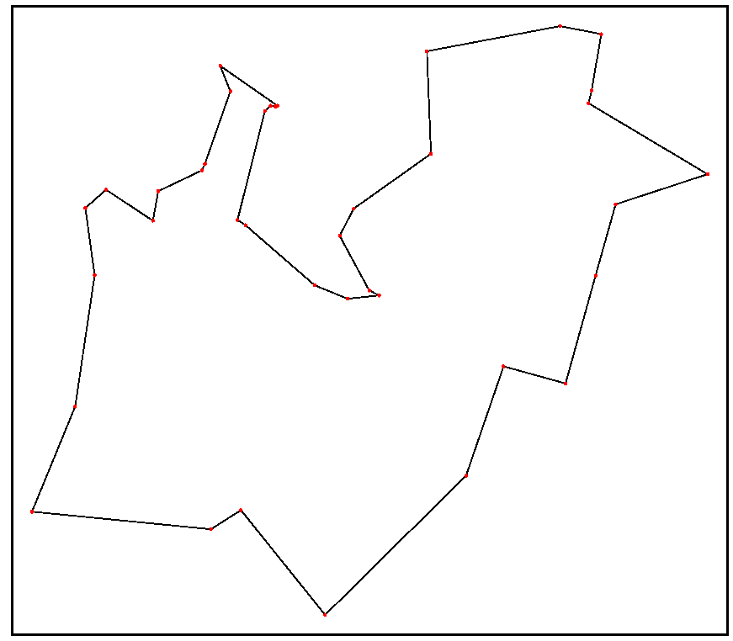
Djibouti: 38 Cities
Ans

Slide 12

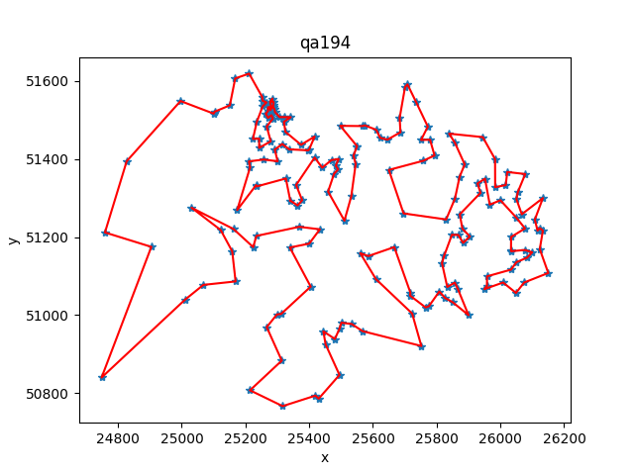
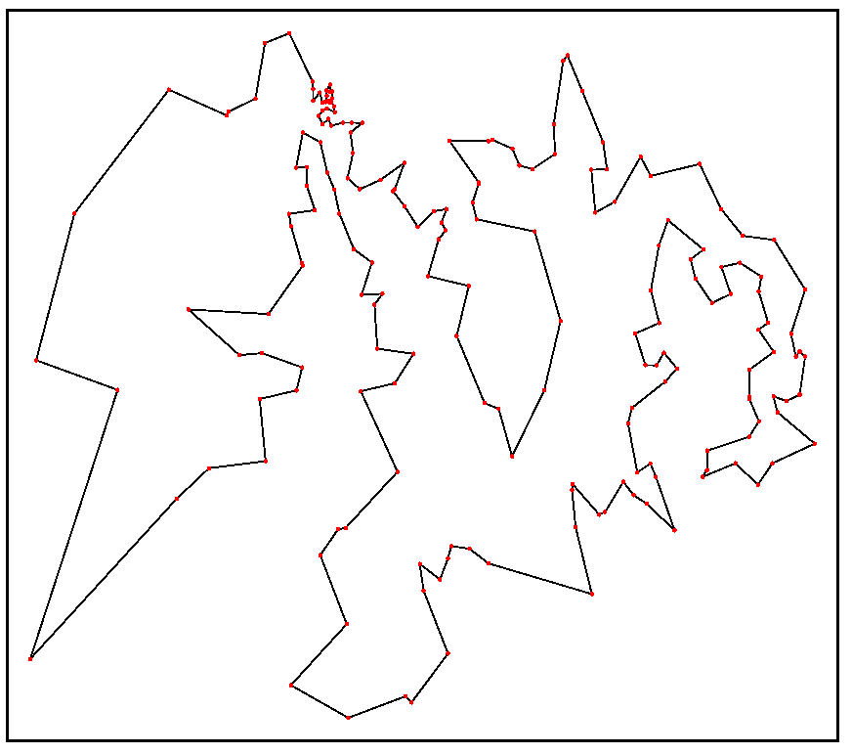
Qatar: 194 Cities
Ans
Distance:10014
Distance: 9352

Slide 13
Conclusion
When the number of cities is small, the accuracy is high and the convergence speed is fast
When there are many cities, the algorithm is easy to converge to a local minimum
This method may not get the best solution, but it can get a fine solution in a relatively short time.

